Slide 1

Strategic Information Systems Management Section 2a SWOT Analysis Class Code: COMP423 H.Y Kan, Stanley Room: (WUI CHI) - 4/F, N46B Email: hykan@ipm.edu.mo Tel: 8599-6883

Slide 2
SWOT Analysis: Evaluating Business Unit Opportunities
Define SWOT (strengths, weaknesses, opportunities, and threats)
First look into business unit
Identify strengths and weaknesses
Then review operating environment
Identify opportunities and threats presented
Take advantage of opportunities
Build on strengths
Avoid threats
Compensate for weaknesses

Slide 3
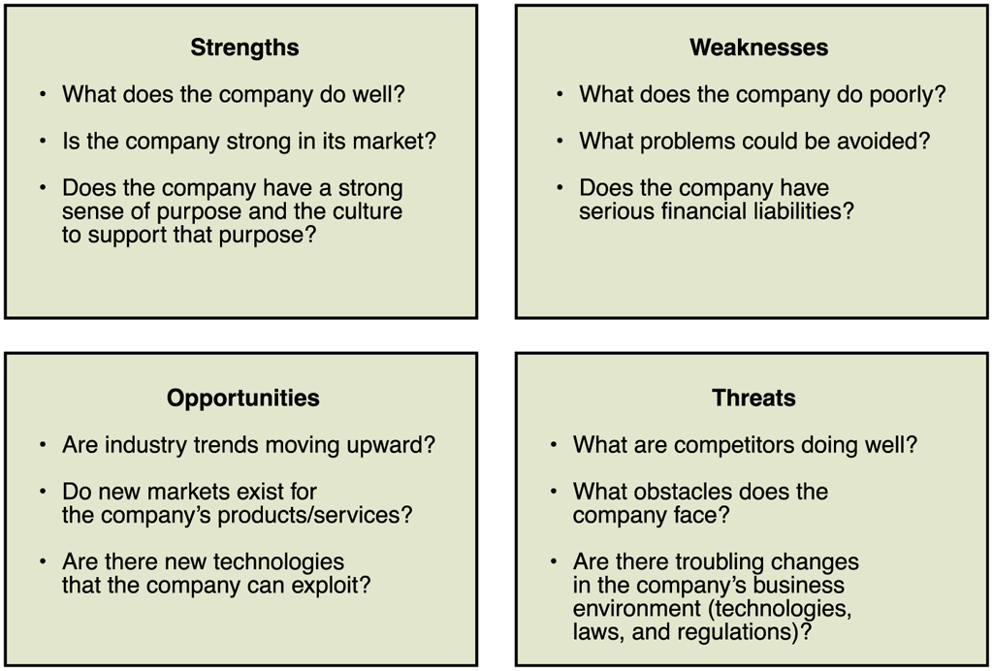
© Cengage Learning 2017
FIGURE 1-11 SWOT analysis questions

Slide 4
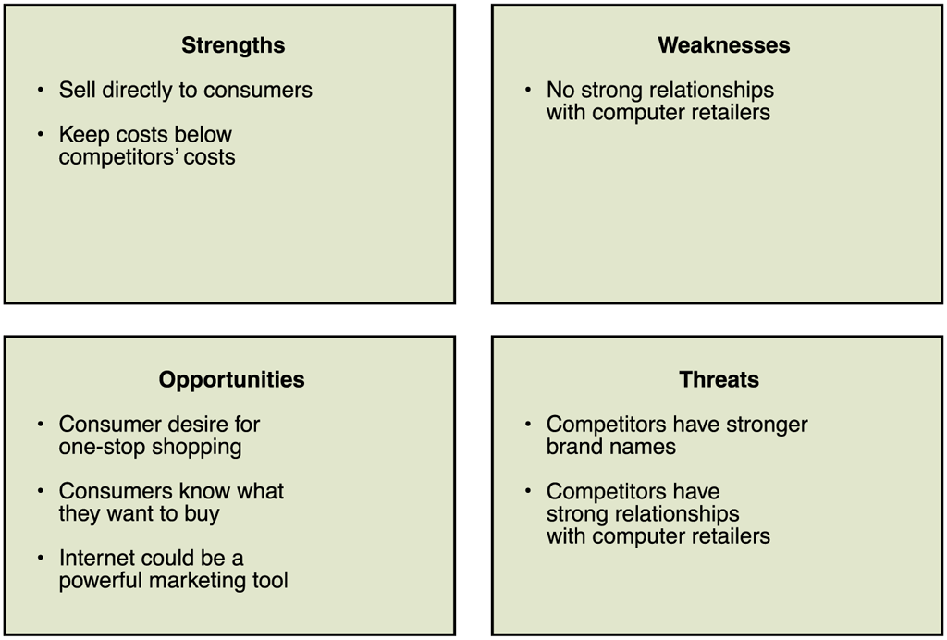
© Cengage Learning 2017
FIGURE 1-12 Results of Dell’s SWOT analysis (in mid 1990s)

Slide 5
After the SWOT analysis, Dell decided to offer customized computers built to order and sold over the phone, and eventually, over the Internet.
Dell’s strategy capitalized on its strengths and avoided relying on a dealer network.
The brand and quality threats posed by Compaq and IBM were lessened by Dell’s ability to deliver higher perceived quality because each computer was custom made for each buyer.
Ten years later, Dell observed that the environment of personal computer sales had changed and did start selling computers through dealers.

